Slide 1
Monthly Director’s Report

Slide 2
What is the Director’s Report ?
BSIP Data
Showing your data to you
Summary and Outlier Information
Produced and Distributed Monthly
Sample Report will come the end of June covering the month of May

Slide 3
Primary Areas Covered
30-day Inspections
Mileage based PMs
Technician Labor Hours
Parts Purchasing Volume
Cost Summaries by Category of Operation (Local 7000s, Local Other, and Yellow Fleet)
Outliers in MPG and Oil Consumed
VMRS Codes
  Top codes used by labor hours
  Assessment of how much the codes are used

Slide 4
Feedback
Any data put in can be retrieved
Look it over give us ideas
  It can’t necessarily have everything but we’ll look into all suggestions
We’ll be refining the report over the summer
Monthly distribution beginning with the new school year

Slide 5
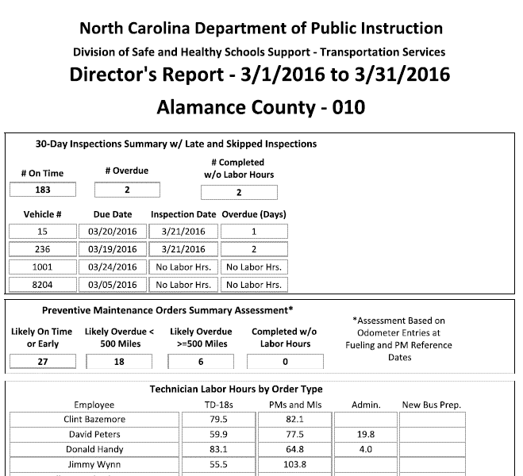
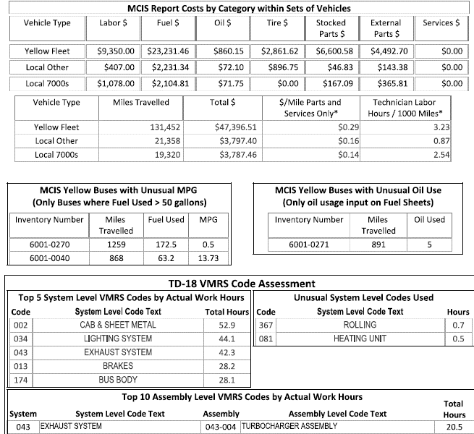

Slide 6
Use It!
Once you have it, ask questions of your staff and ours
We can point you to more details on anything you’re concerned about

